Slide 1
Unit-2
Cont…

Slide 2
Cardinality and Participation Constraints
In general, cardinality tells you "How many".
Cardinality can be:
One to one (1:1): every time one entity occurs, there is exactly one occurrence of another entity.
One to many (1:m): every time one entity occurs, there are multiple occurrences of another entity.
Many to many (m:m): for each occurrence of an entity, there can be one or many occurrences of another—an vice versa.
Participation Constraints:
Total Participation
Partial Participation

Slide 3
Example for 1:1 Relationship Type
In an Entity-Relationship (ER) Model, a 1:1 (one-to-one) relationship means:
One instance of Entity A is associated with only one instance of Entity B, and vice versa.
🔹 Example 1: Person – Passport
Person → Each person has one passport.
Passport → Each passport belongs to one person only.
🔹 Example 2: Husband – Wife
Husband → one wife only.
Wife → one husband only.
📌 Key Point: In ER diagrams, the 1:1 relationship is shown by connecting two entities with a line and placing 1 on both ends.

Slide 4
Example for 1:M Relationship Type
In an Entity-Relationship (ER) Model, a 1:M (one-to-many) relationship means:
One instance of Entity A can be associated with many instances of Entity B.
But each instance of Entity B is related to only one instance of Entity A.
🔹 Example 1: Teacher – Students
Teacher → One teacher can teach many students.
Student → Each student is taught by one teacher (in this relationship).
🔹 Example 2: Department – Employees
Department → One department can have many employees.
Employee → Each employee belongs to only one department.
🔹 Example 3: Mother – Children
Mother → One mother can have many children.
Child → Each child has one biological mother
📌 Key point: "1" is placed on the side where only one instance exists, and "M" (many) is placed on the side where multiple instances exist.

Slide 5
Example for N:M Relationship Type
In an Entity-Relationship (ER) Model, a many-to-many (M:N) relationship means:
One instance of Entity A can be associated with many instances of Entity B,
and one instance of Entity B can also be associated with many instances of Entity A.
🔹 Example 1: Students – Courses
Student → One student can enroll in many courses.
Course → One course can have many students enrolled.
🔹 Example 2: Authors – Books
Author → One author can write many books.
Book → One book can be written by many authors
🔹 Example 3: Doctors – Patients
Doctor → A doctor can treat many patients.
Patient → A patient can be treated by many doctors.
📌 Key point: In practice, an M:N relationship is usually broken into two 1:M relationships using a bridge/associative entity (like Enrollment between Student & Course).

Slide 6
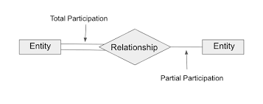
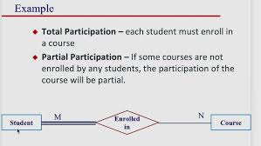
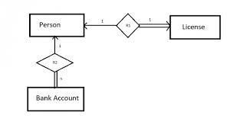
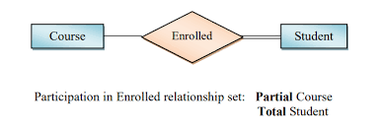
Participation Constraint

Slide 7
Degree of a Relationship
Based on the number of linked entity types, we have 4 types of degrees of relationships.
Unary
Binary
Ternary
N-ary

Slide 8
Unary Relationship
In this type of relationship, both the associating entity type are the same. So, we can say that unary relationships exist when both entity types are the same and we call them the degree of relationship is 1. Or in other words, in a relation only one entity set is participating then such type of relationship is known as a unary relationship.
Example: In a particular class, we have many students, there are monitors too. So, here class monitors are also students. Thus, we can say that only students are participating here. So the degree of such type of relationship is 1.

Slide 9
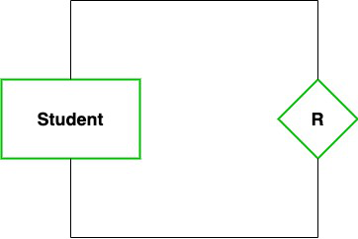
Example – Unary Relationship

Slide 10
Binary Relationship
In a Binary relationship, there are two types of entity associates.
Binary relationship exists when there are two types of entity and we call them a degree of relationship is 2.
Or in other words, in a relation when two entity sets are participating then such type of relationship is known as a binary relationship. This is the most used relationship and one can easily be converted into a relational table.

Slide 11
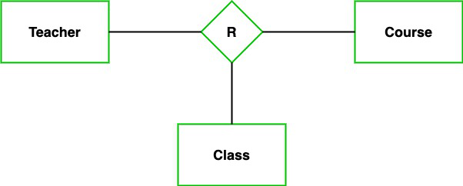
Ternary Relationship
In the Ternary relationship, there are three types of entity associates.
Ternary relationship exists when there are three types of entity and we call them a degree of relationship is 3

Slide 12
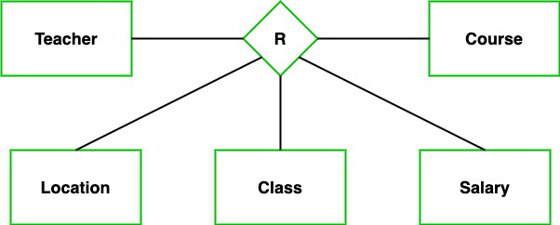
N-ary Relationship
In the N-ary relationship, there are n types of entity that associates.
N-ary relationship exists when there are n types of entities.

